Slide 1


DATA KNIGHTS PROJECT
WOMENTECHSTERS BOOTCAMP 3.O
11th of October, 2023

Slide 2
UNVEILING THE ROOTS OF AFRICAN POVERTY
TOPIC
SUSTAINABLE DEVELOPMENT GOAL 1
NO POVERTY

Slide 3





CONTENT
Objectives
Introduction
Methodology
Insights
Recommendations

Slide 4
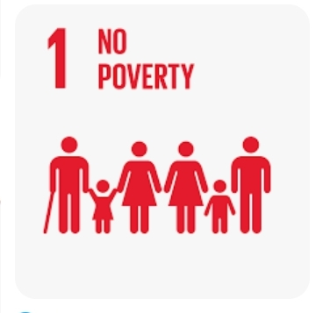
OBJECTIVES
To delve deep into the causes of poverty in Africa, focusing on variations across West (Nigeria and Sierra Leone) and Eastern (Kenya, Uganda and Mozambique) African regions.
To identify these factors and propose effective strategies for alleviation.

Slide 5
INTRODUCTION
Africa faces the grim reality of being the world’s poorest continent, with over 430 million people living on less than $1.90 per day.
Our analysis can contribute to the design of more impactful poverty alleviation programs

Slide 6
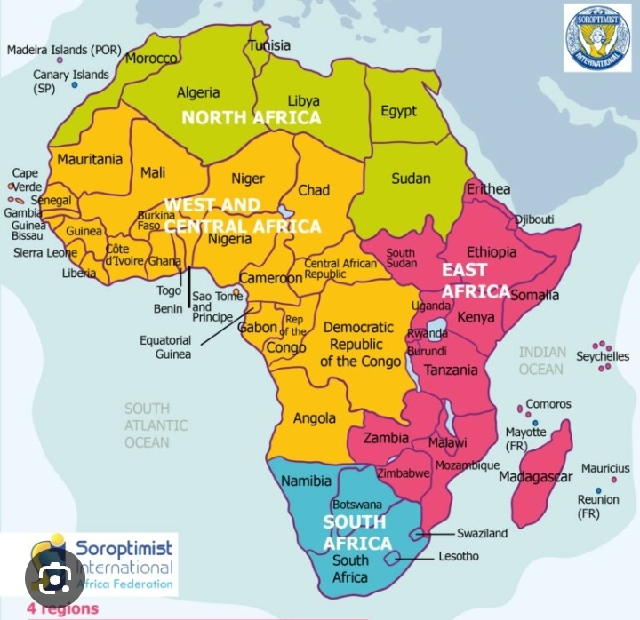





COUNTRIES
Kenya (East Africa)
Mozambique (East Africa)
Nigeria (West Africa)
Sierra Leone (West Africa)
Uganda (East Africa)

Slide 7

METHODOLOGY
Data Gathering
Dataset description
Analysis Tools
Data Cleaning and Preparation
Data Modelling
Data Visualization and Dashboard

Slide 8

DATA GATHERING
World Bank Development Research group
World Bank account data, and OECD national account data files
World Bank Staff estimates based on age distribution of United Nations Populations Divisions World Population Prospects:2022 Revisions
International labour organization “ILO Modelled Estimates and Projections database (ILOEST)” ILOSTAT.

Slide 9
DATASET DESCRIPTION
A collection of socio-economic and demographic indicators for selected African countries over 10 years.
Here is a description of some of the data fields:
GDP Growth: the annual growth rate of a country's Gross Domestic Product .
GDP per capita: GDP of a country divided by its total population
Income Group: categorizes countries into income groups based on factors like their GDP per capita
Dependent old age: percentage of the population that is considered elderly, typically those aged 65 and older
Unemployment rate: percentage of the labor force that is currently unemployed
Limited access to drinking water: percentage of the population in a country that lacks adequate access to clean and safe drinking water sources

Slide 10

TOOLS
Microsoft Excel: Data Exploration, Data Cleaning and Preparation
Microsoft Word: Documentation and Reporting
Microsoft Power BI: Data Visualization, and dashboard
Microsoft Teams: Collaboration, and Sharing Reports
Microsoft PowerPoint: Presentation of Findings
Microsoft Power Query: Data Transformation

Slide 11

DATA CLEANING
The Data Cleaning process was accomplished with Microsoft Excel and Power Query
Refined our datasets by filtering out countries that were not part of the case study
Transformed these indicators to their suitable data types
Transformed the date column to the appropriate date type
Remove duplicated and unnecessary rows and columns.
Saved all cleaned datasets appropriately

Slide 12
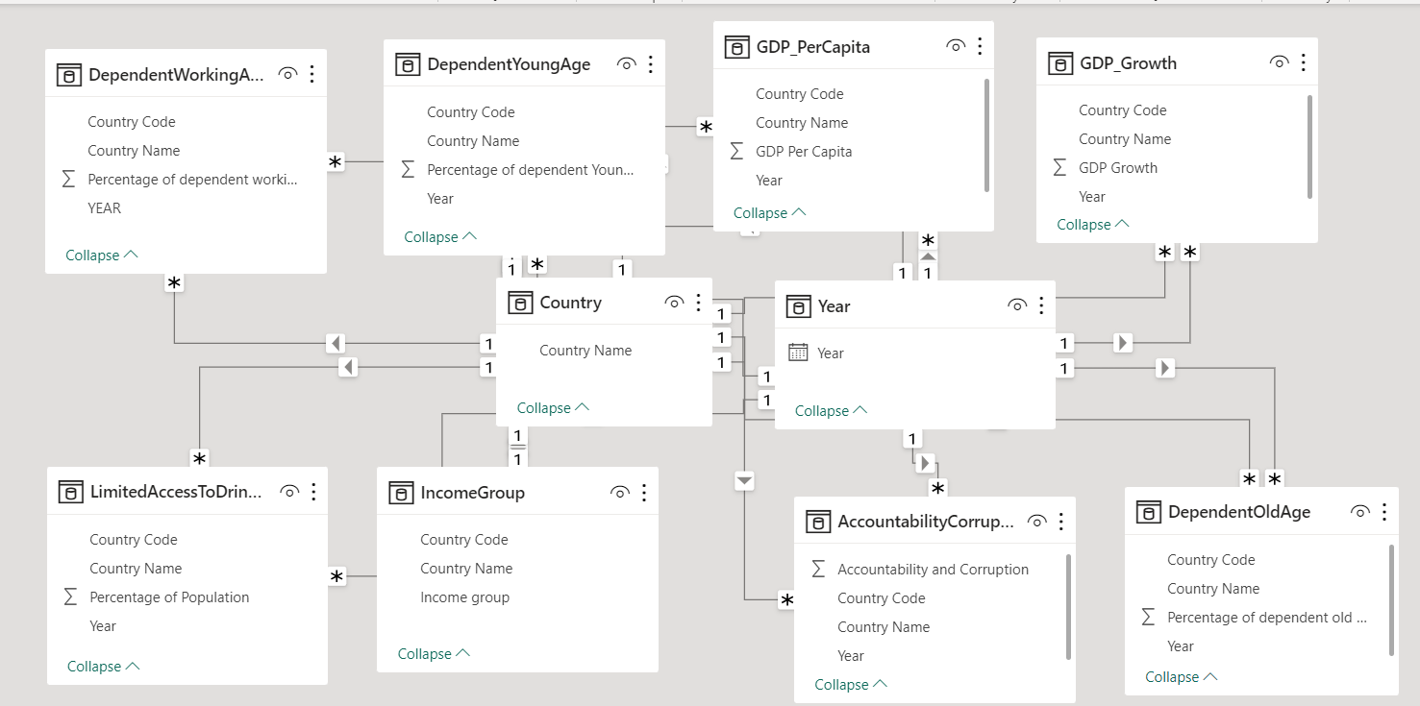

DATA MODEL

Slide 13
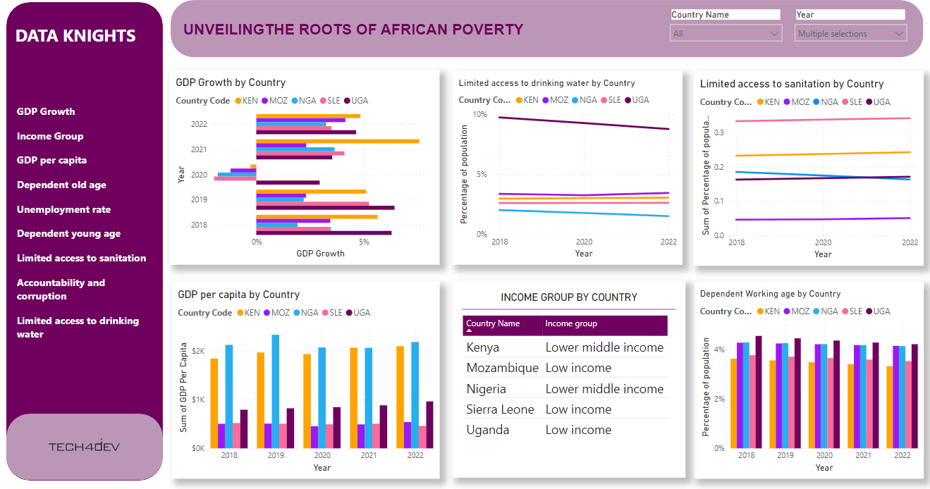

Slide 14
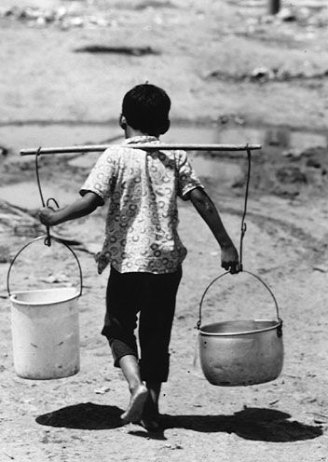
INSIGHTS
Limited access to drinking water
Limited access to sanitation
Age dependency ratio
Unemployment rate
Income group
Accountability and corruption
GDP growth
GDP per capita

Slide 15
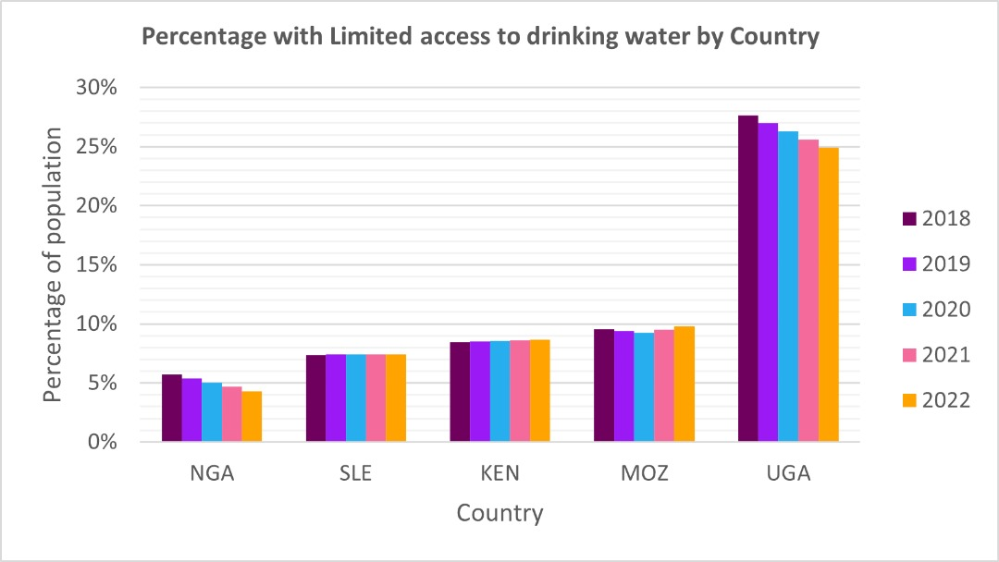
Limited access to drinking water
RECOMMENDATIONS
Promote public awareness campaigns to educate Ugandans about the importance of clean water and proper sanitation practices
Investment in water infrastructure
International Aid
Policies that ensure equitable access to clean water
Involve local communities in the planning and management of water resources
Uganda has the highest population with limited access to drinking water

Slide 16
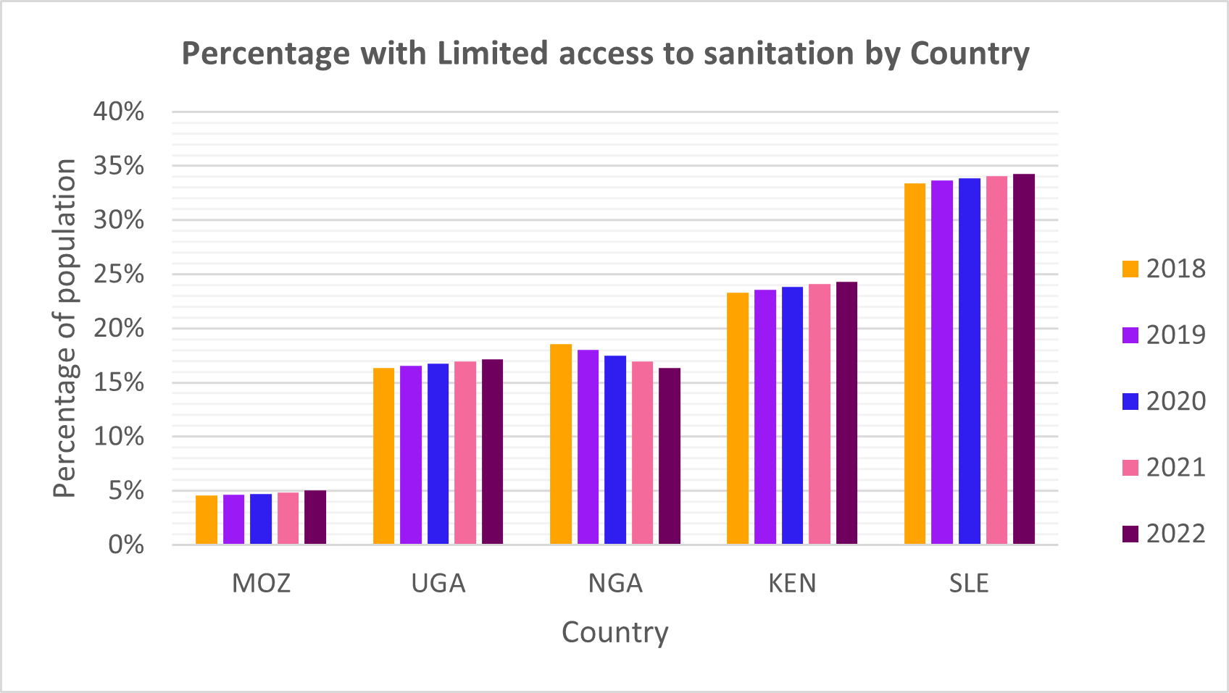
Limited access to sanitation
RECOMMENDATIONS
Promote Hygiene Education
Development and enforcement of sanitation policies and regulations
Promote community-led sanitation initiatives, which involve local communities in planning, building, and maintaining sanitation facilities
Address the issue of waste management by developing efficient waste collection and disposal systems
Advocate for increased investment in sanitation infrastructure in Sierra Leone
Sierra Leone has the highest member of its population with limited access to sanitation

Slide 17
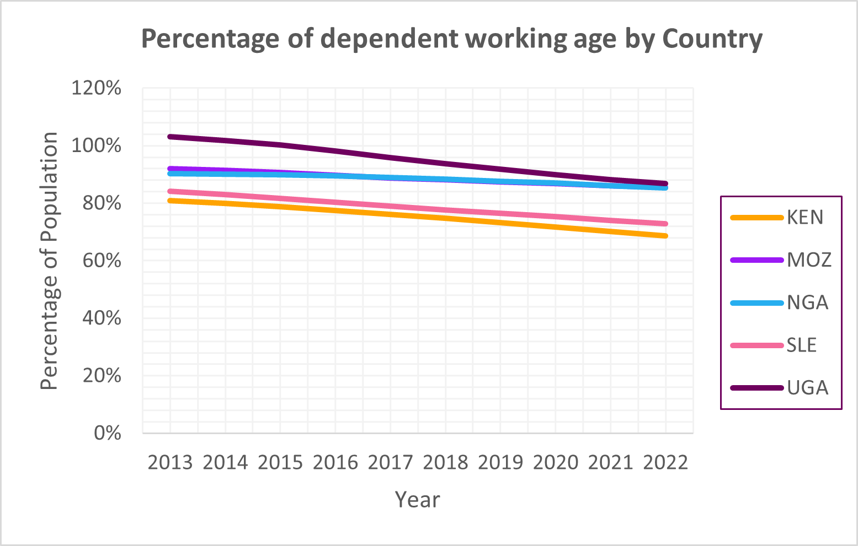
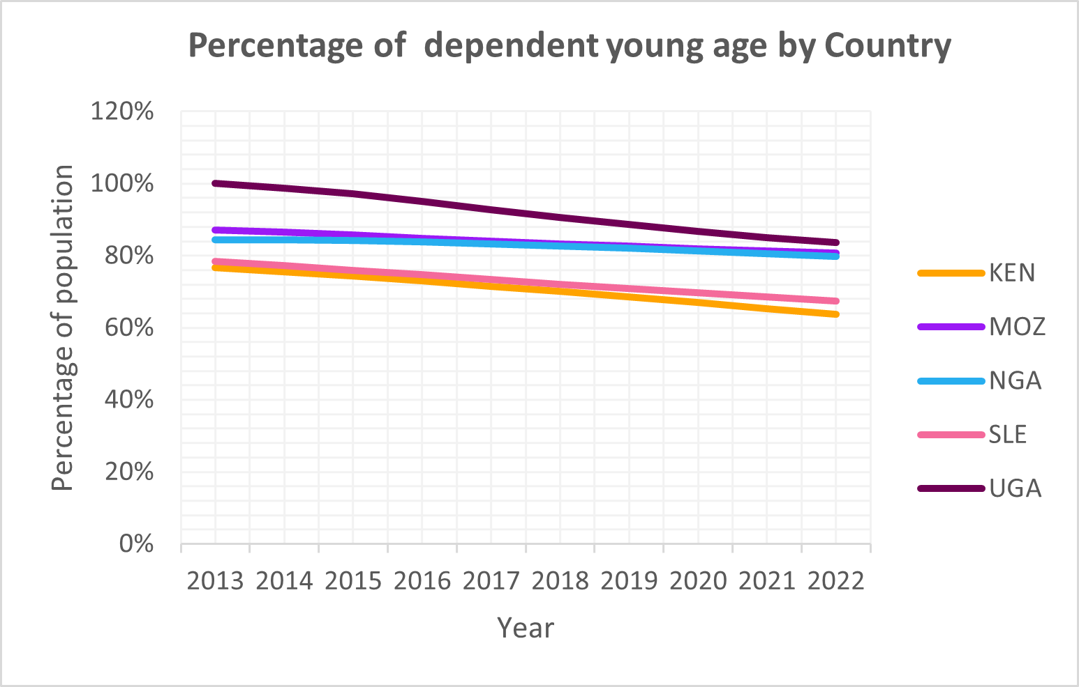
Age dependency Ratio
Uganda, Mozambique, and Nigeria have the highest working age that is dependent while Kenya has the lowest working age that is dependent.
Uganda, Mozambique, and Nigeria have the highest young age that is dependent while Kenya has the least young age that is dependent.

Slide 18
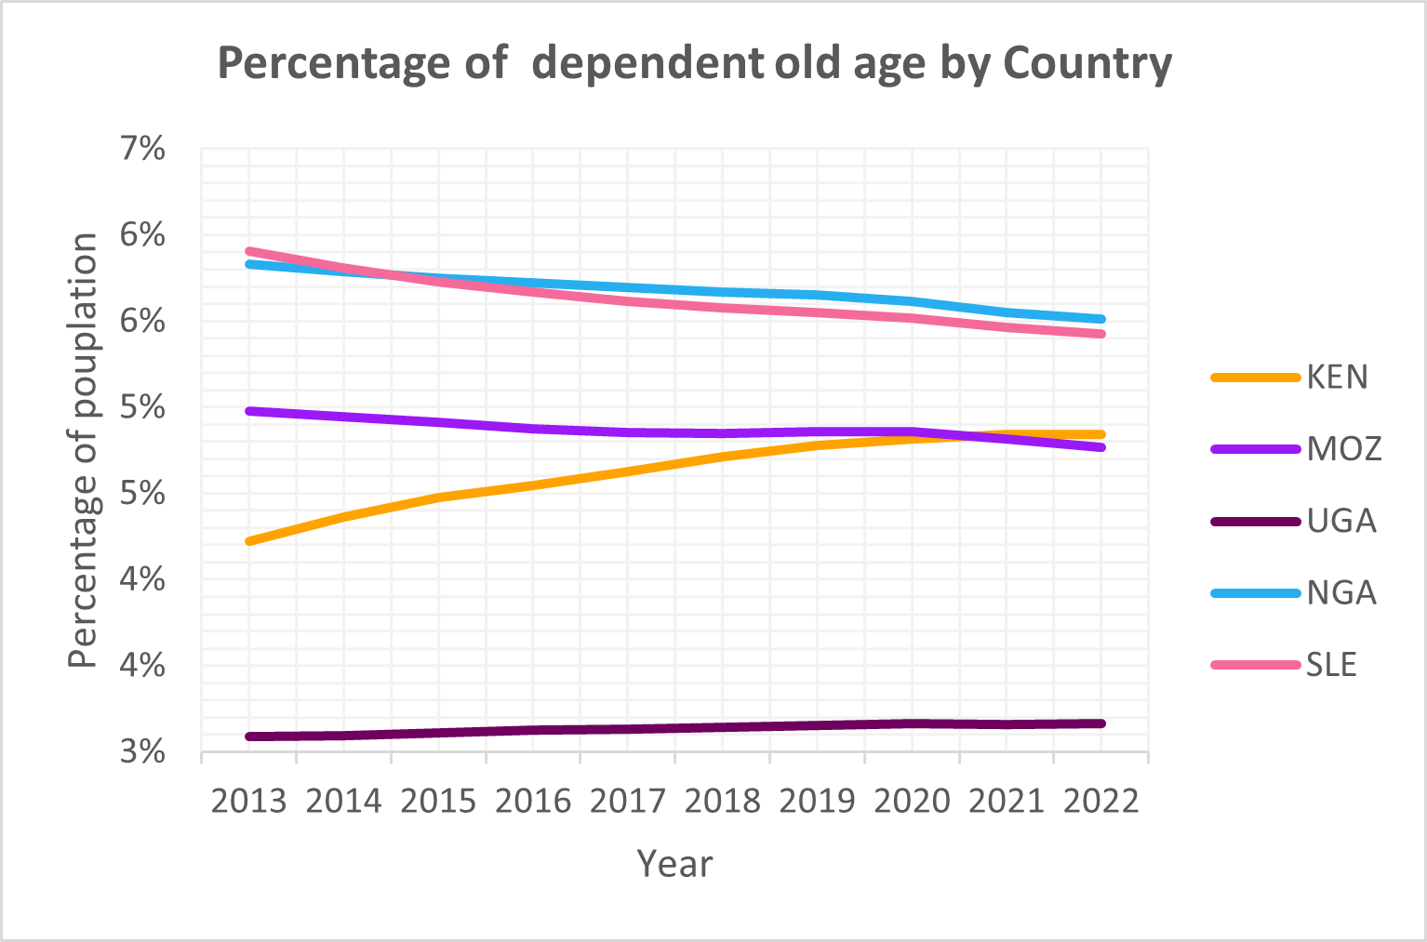
Age dependency
Causes of the high dependency ratio
Health Issues
Traditional Family Structures
Lack of Adequate Healthcare
Lack of Social Welfare Programs
Limited Educational Opportunities
Economic Factors, Social and Cultural Factors
Nigeria and Kenya have the highest old-age that are dependent while Uganda has the least old-age that are dependent.

Slide 19
RECOMMENDATIONS
Improve access to quality healthcare
Invest in education, particularly for women and girls
Provide opportunities for skill development, education, and training for young people to prepare them for the workforce and encourage delayed childbearing.
Foster economic growth and job creation to increase employment opportunities for the working-age population, reducing economic dependency.
Establish or expand social welfare programs and safety nets
Develop and expand formal pension and retirement savings systems to reduce the financial burden on the working-age population when supporting the elderly.

Slide 20
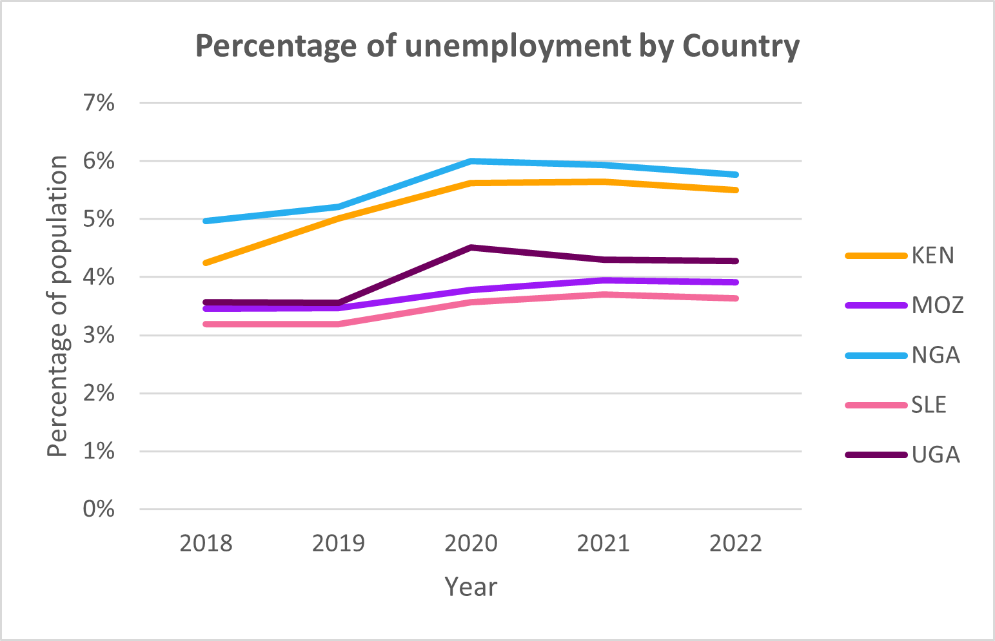
Unemployment rate
RECOMMENDATIONS
Encourage economic diversification to create opportunities in various sectors beyond traditional industries.
Invest in education and vocational training programs that equip individuals with the skills needed for available job opportunities
Foster a culture of entrepreneurship and innovation by providing incentives and support for start-ups
Review and reform labor market policies to make it easier for businesses to hire and fire employees
Invest in infrastructure projects that create jobs directly and support economic growth
Develop programs specifically designed to address youth unemployment
Nigeria and Kenya have the highest percentage of their population unemployed.

Slide 21
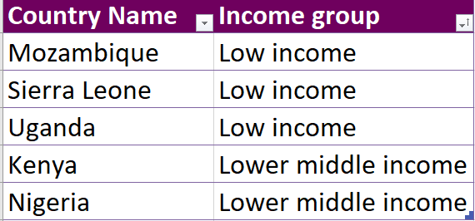
Income Group
RECOMMENDATIONS
Low-Income Countries
Invest in modernizing the agricultural sector to enhance food security and increase the income of rural populations, who often constitute a significant portion of the poor.
Promote microfinance and provide support for small and medium-sized enterprises (SMEs) to stimulate entrepreneurship and local economic development.
Support the growth of manufacturing industries and promote exports to strengthen the international trade position and create more jobs.
Promote transparency, reduce corruption, and enhance governance to create a favorable business environment and attract investments.
Low middle Income Countries
Mozambique, Sierra Leone, and Uganda are Low-income countries while Nigeria and Kenya are Lower middle-income countries.

Slide 22
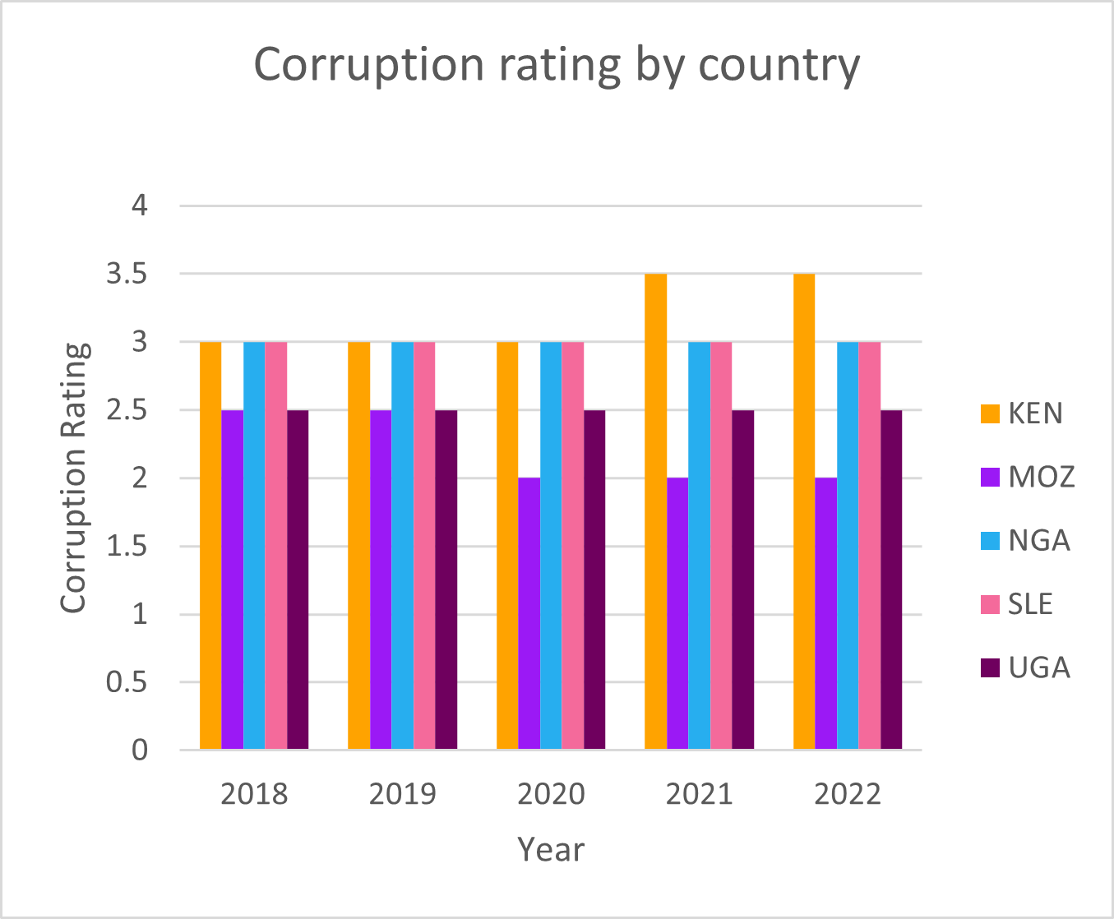
Accountability and Corruption
INSIGHTS
The corruption index across the selected countries has an average of 3 (middle of the index) signifying that there have been some corrupt practices that have been built and sustained over the years. This implies misallocation of public resources; whereby investments in poverty reduction are delayed or insufficient contributing to the poverty rate.
RECOMMENDATIONS
Policies and measures should be put in place to ensure that allocated funds for essential services such as education, healthcare, and infrastructure are not diverted for personal gain or channeled into corrupt projects.

Slide 23
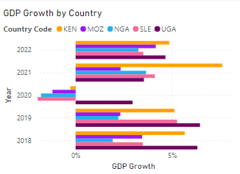
Gross Domestic Product (GDP)
INSIGHTS
There has been a fluctuation in the GDP growth percentage within the years explored. This infers that there was slower economic activity, which can lead to fewer job opportunities and higher employment rate 2020 was a peculiar year as most of the studied countries experienced a negative GDP growth indicating that the total economic output significantly decreased over a specific period, i.e. fewer production of goods and services due to COVID and other global crisis.
These low GDP growth over the years infers a deterred domestic and foreign investment which in turn leads to economic opportunities being constrained. This hinders the government's ability to invest in and expand access to essential services such as healthcare, education, and clean water. This can disproportionately affect low-income individuals and communities thus contributing in the poverty rate.

Slide 24
RECOMMENDATIONS
Government can increase spending on infrastructure projects, education, healthcare, and other public goods and services. This boosts demand in the economy, creates jobs, and stimulates economic activity.
Investing in education and skill development programs can improve the quality of the workforce, making it more attractive for businesses to invest and expand in the country.

Slide 25
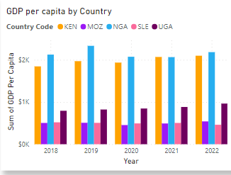
GDP Per Capita
INSIGHTS
Sierra Leone (Smallest GDP per capita)
a) Sierra Leone has the lowest GDP per capita among the five countries.
b) It faces significant economic challenges, which may include high poverty rates, limited access to basic services, and development needs.
2. Mozambique
a) Mozambique's GDP per capita is higher than Sierra Leone but still relatively low.
b) The country may be in a stage of economic development characterized by ongoing challenges, such as infrastructure development and poverty reduction efforts.

Slide 26
GDP Per Capita
Uganda
a) Uganda has a higher GDP per capita compared to Mozambique.
b) It might be experiencing moderate economic development, with some improvements in income levels and living standards.
Kenya
a) Kenya's GDP per capita is higher than Uganda's, indicating a more developed economy.
b) The country may have a larger middle class, better infrastructure, and more diversified economic activities.
Nigeria (Highest GDP per capita)
a) Nigeria boasts the highest GDP per capita among the five countries.
b) It may be considered an economic powerhouse in the region, with more extensive industries, services, and potentially a larger urban population.

Slide 27
RECOMMENDATIONS
Poverty Alleviation Programs: Focus on targeted poverty alleviation programs in countries with the lowest GDP per capita, such as Sierra Leone and Mozambique. These programs can include cash transfers, food assistance, and vocational training to help the poorest populations.
Economic Diversification: Encourage economic diversification in countries with lower GDP per capita. Help them reduce dependency on a single industry or export by investing in and developing other sectors to create more job opportunities.
Agricultural Development: Support agricultural development in these countries, as it often plays a crucial role in reducing rural poverty. Investments in modern farming techniques, infrastructure, and access to markets can enhance agricultural productivity.

Slide 28
RECOMMENDATIONS
Access to Education: Prioritize access to quality education, especially in countries with lower GDP per capita. Education is a pathway out of poverty, and improving educational systems can lead to better job prospects.
Access to Healthcare: Ensure affordable and accessible healthcare services to prevent families from falling into poverty due to medical expenses. Healthier populations are more productive and economically secure.
Microfinance and Small Business Support: Promote microfinance initiatives and provide support for the growth of small businesses, particularly in countries like Sierra Leone and Mozambique. These initiatives can stimulate entrepreneurship and income generation.

Slide 29
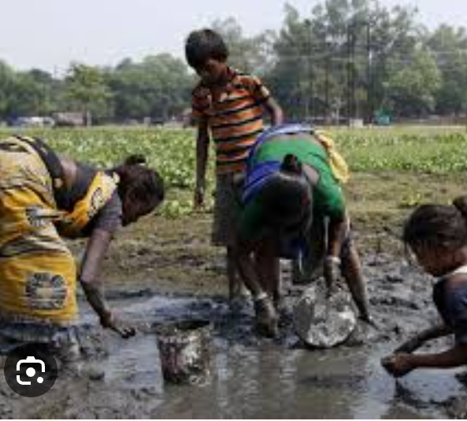
CONCLUSION
Factors affecting Poverty in both the East and West Africa Region
Limited access to clean drinking water & Sanitation
Limited access to health care facility
Food scarcity
High illiteracy rate
High unemployment rate
Lack of accountability and
High rate of corruption

Slide 30

Project Results

Slide 31

Project Results

